Slide 1
Computer Modelling of Cooperative ITS: Tools and Results
Tibor Petrov
Department of Multimedia and Information-communication Technologies
Faculty of Electrical Engineering, University of Žilina, Slovakia

Slide 2
Contents
C-ITS Overview
C-ITS Standards
Computer Modelling Tools
Simulation Results
Conclusion and Further Research Topics

Slide 3
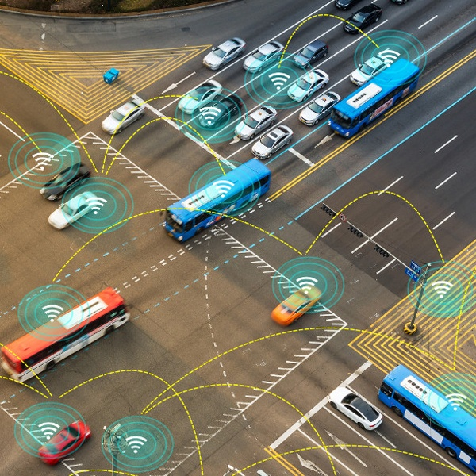
C-ITS Overview
Based on communication between vehicles and vehicles and roadside infrastructure
Increase of current road infrastructure transport capacity
Better transport safety and efficiency
Decrease of environmental impact
Communicating nodes-> VANET
http://safecarnews.com/australia-stablishes-connected-vehicle-network-c-its-by-2017/

Slide 4
C-ITS Standards
IEEE 1609 WAVE
ETSI ITS
ISO CALM
ARIB STD-T109
IETF Ipwave (Draft)
PHY and MAC -> IEEE 802.11p
Extensions (ETSI ITS DCC)

Slide 5
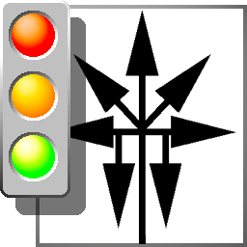
Computer Modelling Tools
Network simulators
OMNeT++
NS-2
OPNET Modeler
QualNet
NCTUns
Traffic Simulators
SUMO
VanetMobiSim
MOVE
STRAW
FreeSim
CityMob
Simulation Frameworks
VEINS
ARTERY
OMNeT++ Discrete Event Network Simulator + Veins framework + SUMO traffic simulator + Custom traffic flow generator tool for SUMO
Simulation of Urban MObility

Slide 6
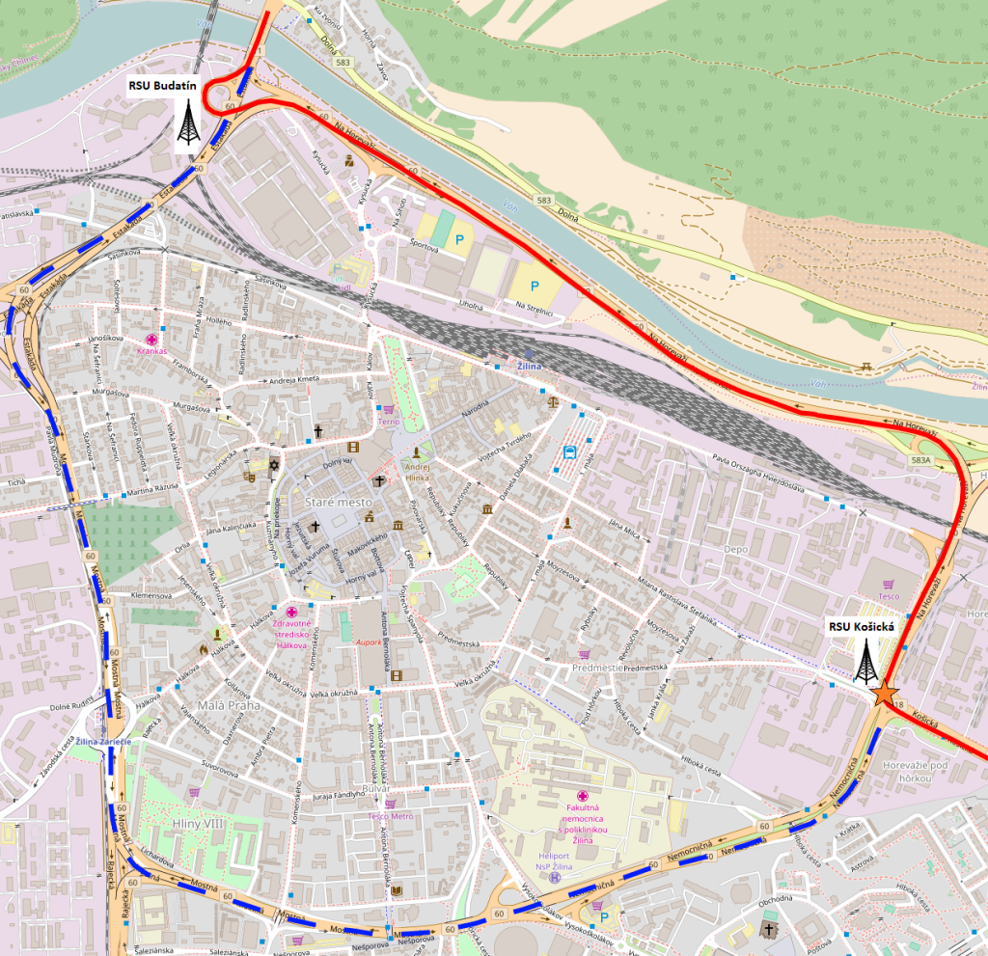
Simulation Results I
Three simulations performed:
Pure V2V communication
Combination of V2V & V2I communication
Optimized V2V & V2I communication
Topology:
Vehicles
Vehicles + two RSUs

Slide 7
Video footage here...

Slide 8
Simulation Results II
V2V communication only – high load of the RF channel, lot of messages to be processed
Combination of V2V & V2I – decreased message spreading time, computational load on the onboard units & channel load, occasional redundant transmissions
Optimized V2V & V2I – redundant transmissions suppressed, further slight improvement of network performance parameters

Slide 9
Conclusion and Further Research
Delays and RF channel load are well under their limits => it is possible to operate such an application at the proposed road segments in Žilina
A combination of V2V & V2I communication seems to be a better option for traffic warning applications
IPv6-based addressing and routing can be very beneficial for network performance optimization and targeted transmissions if appropriate protocol for vehicular environments is optimized and implemented correctly
Further research:
IPv6 implementation in vehicular networks
Effectivity of various routing protocols in VANETs
C-ITS for emergency vehicles coordination

Slide 10
Acknowledgements
Research described in this presentation was supported by the ERAChair Eradiate - Enhancing Research and innovation dimension of the University of Zilina in intelligent transport systems, Grant agreement no: 621386, Project 7thFP.

Slide 11
Thank you for your attention!

